Slide 1
Tanzania Water Pumps
Predict the functionality of water pumps in Tanzania
Members: Anchit Singh, Julian Ghadially, Matt Bonfante, Molly Wolfe, Vijai Kasthuri Rangan

Slide 2
Functionality Types & Difference
Functional - A WPT is functional if it yielded good quality water during the survey or it had no technical problems even if water was not present in a water point but it is available seasonally
Non functional - A WPT is non-functional if it did not yield water for more than six months of the year. Reasons for non functionality such as being dry, poor water quality (for example too salty or too much fluoride), or due to management. Non-functional also includes those WPT that are under construction but not yet operational
Functional Needs Repair – A WPT that is functional / operational but needs repair to operate at capacity

Slide 3
The Problem
Did you know?
Unclean water causes more deaths each year than all forms of violence (including war)
Tanzania
56% of rural areas lack access to water
Government has limited resources
It costs more to replace a pump than to repair

Slide 4
Goal
Primary goal:
Identify Functional needs repair
Secondary goal: predict functionality of other classes
Fully functional
Non functional

Slide 5
The Data
Dataset is from Taarfia and Tanzanian Ministry of Water
Taarfia: open source platform for the crowd sourced reporting and triaging of infrastructure related issues
Each record represents an individual pump ~ 75,000 total entries
40 features (i.e. demographics, water quality)

Slide 6
Outline
EDA
Pre processing
Models
Results and Recommendations

Slide 7

Water Quantity vs Functionality

Slide 8

Payment vs Functionality

Slide 9

Management vs Functionality

Slide 10
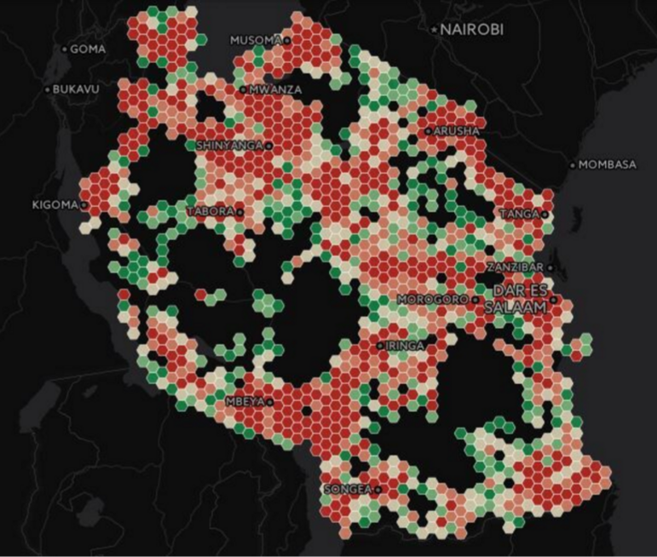
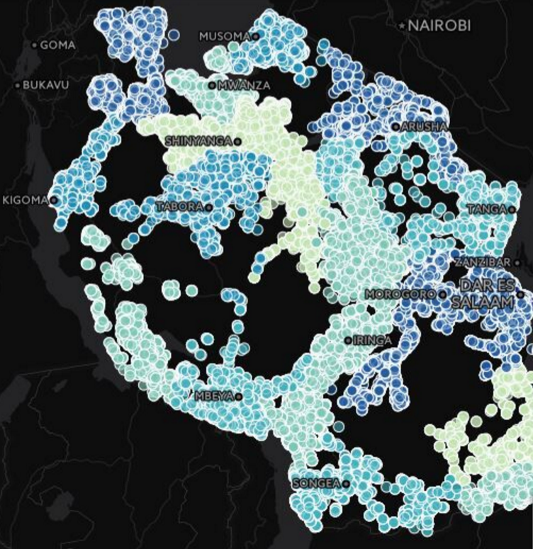


Population & Crime Density
Population spread across region
Crime rate across region

Slide 11
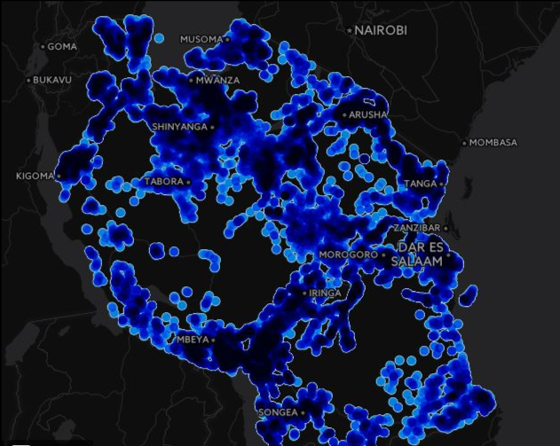
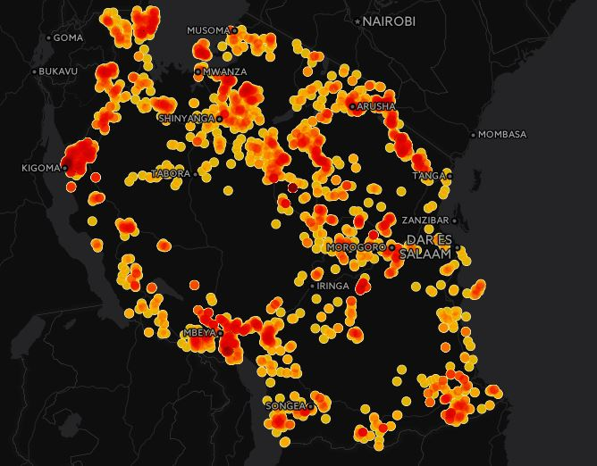
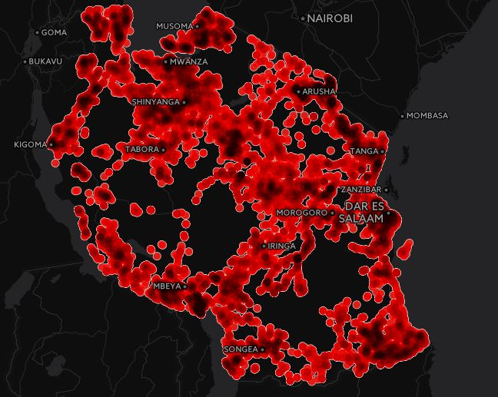
Functionality
Functional
Functional needs repair
Non Functional

Slide 12
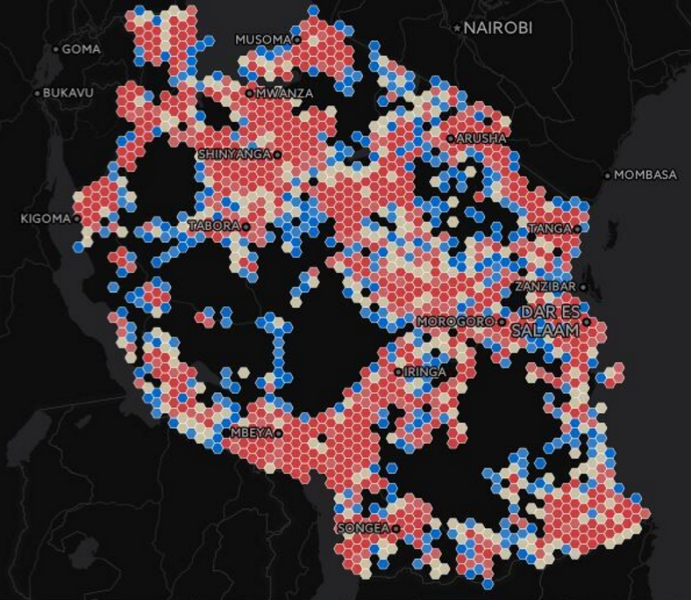
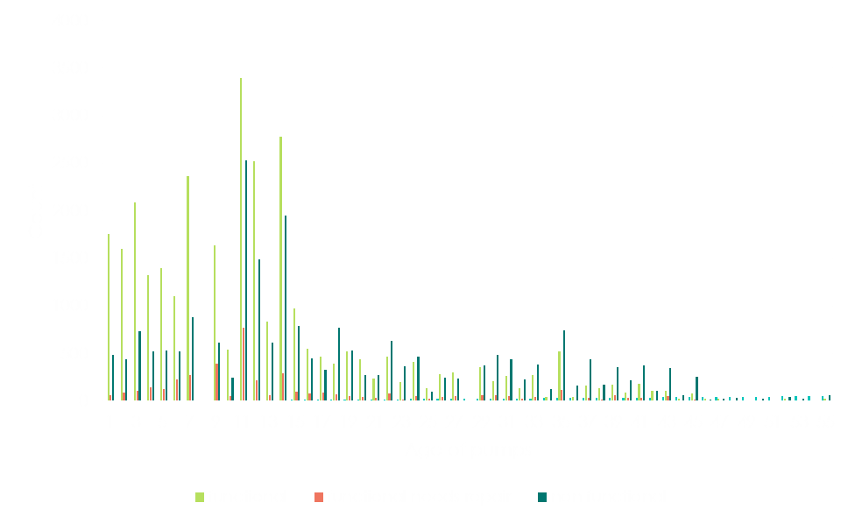

Age of Pumps vs Functionality
Age of pumps across different regions

Slide 13
Preprocessing - Imputation
Construction Year
Found the median construction year to be 2000
Used water point type, region to impute the construction year
Used Date Recorded and imputed construction year to create the AGE feature
Population
Population had >21k zero values
Used the publicly available census data for ward level population
Population was found to be a significant variable in the models we developed
Longitude & Latitude
Used district and region to identify the long lat for missing observations
Imputed this in the data

Slide 14
Categorical Variables
Converted NAs to unknowns (for all categorical variable)
Performed text translation and used NLTK to find most frequent occurring words
Based on the theme grouped categories to decrease the number of levels
Using the frequency of these classes across the status group – “Functional needs repair”, selected the top 10
LGA (Local Government Authority)

Slide 15
Addition of external data
We obtained publicly available data and added it to the data set:
Crime
Health
Employment
Added these features as ordinals to the data
Sources:
Tanzania Open Dataset - http://opendata.go.tz/dash
Water Point Mapping - http://wpm.maji.go.tz/
Tanzania City Population - http://www.citypopulation.de/php/tanzania-admin.php

Slide 16
Class Imbalance
7% of the data has functional needs repair – The class that we would want to predict
Two ways we approached:
Down sampling
Include costs in the model using ROC curves
Test the models with different down samples and measure the F1 score
Use ROC curves to check how FPR and TPR varies with different thresholds and find the optimal threshold
Notes:
* Use models to predict multiclass but focus on reducing the false positives

Slide 17

Multi-class Regularized Logistic Regression
Accuracy: 69.5%
Sensitivity: 53%
Specificity: 90%
Precision: 30%
F1 Score: 0.383
Take away: Because it costs much more to let a pump needing repair to “go bad,” it’s worth it to send someone to fix a pump with 30% chance it needs fixing, if you end up identifying 53% of repair-able pumps.

Slide 18
Feature Reduction
Sparse matrix of 1100+ dummy categories
Lasso selected 243, ranked by magnitude of beta
Region, extraction type, scheme name, local gov. authority
Reduced Feature set used in multi-level models

Slide 19
Multi-Level Model: Geographic Divisions of Tanzania
Region (wkoa’s)
District (milaya’s)
Divisions (migawanyiko’s)
Wards
Street
Perfect for Hierarchical Model

Slide 20
Multi-Level Model
Fixed effects: Reduced Feature Set from Lasso
Random effects:
Extraction type by region
Scheme name by region
Working out issues related to non-convergence

Slide 21
Multi-Level Model Results (in progress)
Accuracy: 86%
Sensitivity: 40.6%
Specificity: 90%
Precision: 32.4%
F1 score: 0.36

Slide 22

Naïve Bayes
Used all features in the training data
50% down sample of “functional needs repair“ class
Results
Accuracy – 62%
Threshold – 0.995
F1 Score – 0.301

Slide 23
SVM
Model uses all variables except extraction_type, lga, date_recorded
Used Linear Kernel in the first iteration and then chose radial kernel
Found the probability split across the different classes
Plot the ROC curve to find the optimal cutoff for classification – Choosing low false positive rate of 0.1
Threshold - 0.71

Slide 24

SVM - Results
For Linear Model
Overall Accuracy – 64%
F1 Score – 0.2939
For Radial Model
Gamma – 1, C – 0.001
Overall Accuracy – 68%
F1 Score – 0.3124

Slide 25
GBM
Gradient Boosted Machines - Used all the features except lga to build different number of trees/machines
Run on training set with 50% positive class
Iterated through 500 trees and found 180 trees to be ideal

Slide 26

GBM - Results
Accuracy – 75.15
Threshold from ROC – 0.723
F1 score – 0.434

Slide 27
Random Forest - Results
Similar training data set to build model
Compare with GBM
Results:
Accuracy – 0.772
Threshold from ROC – 0.731
F1 score – 0.578
- RF

Slide 28
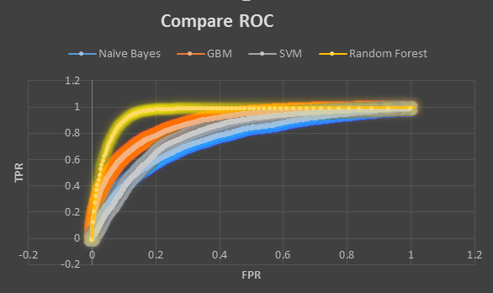
Final Result
Best model: Random Forest
Accuracy : 77% on validation set
F1 Score : 0.578
Model | Accuracy | F1 Score
Logistic Regression | 69.50% | 0.38
MLM | - | 0.36
Naïve Bayes | 62% | 0.3
SVM | 68% | 0.31
GBM | 75% | 0.43
Random Forest | 77% | 0.73

Slide 29
Recommendations / Improvements
We would go ahead with Random Forest
We plan to improve the models by:
Fine tune individual models
Try deep learning models (ex. MLP)
Try different sampling techniques to handle imbalance (Upsampling, SMOTE)
Ensemble different models
Feature engineering techniques – PCA, FLDA

Slide 30
Thank you!

Slide 31
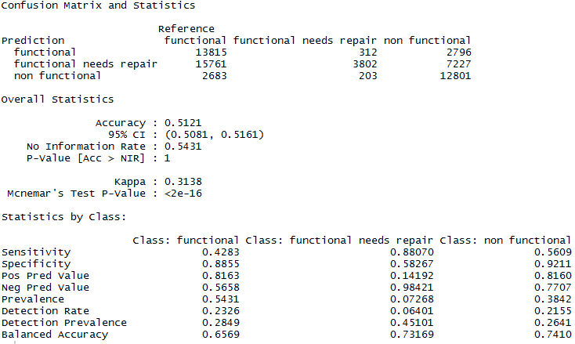
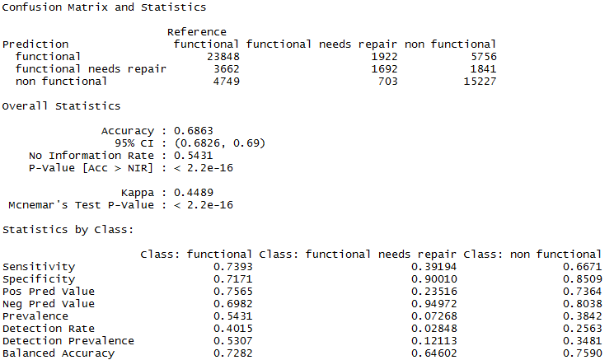
Appendix - SVM - Results

